Slide 1


First Problem:
Name: Life, the Universe, and Everything
Code : TEST
Time Limit : 3 seconds
Source Limit: 50,000 bytes
Link: www.codechef.com/WORKSHOP
Soumyadeep Roy
CSE 2nd Year
Kalyani Government Engineering College

Slide 2
Life,the Universe and Everything
Your program is to use the brute-force approach in order to find the Answer to Life, the Universe, and Everything. More precisely... rewrite small numbers from input to output. Stop processing input after reading in the number 42. All numbers at input are integers of one or two digits.
Problem Statement:

Slide 3
Life,the Universe
and Everything
Rewrite the input to the output till you read the number 42. All numbers at input are integers of one or two digits.
Refined Statement:

Slide 4
Life,the Universe
and Everything
Rewrite the input to the output till you read the number 42. All numbers at input are integers of one or two digits. (Note: input are small numbers)
Refined Statement:

Slide 5
Input:
1
2
88
42
99
Output:
1
2
88

Slide 6
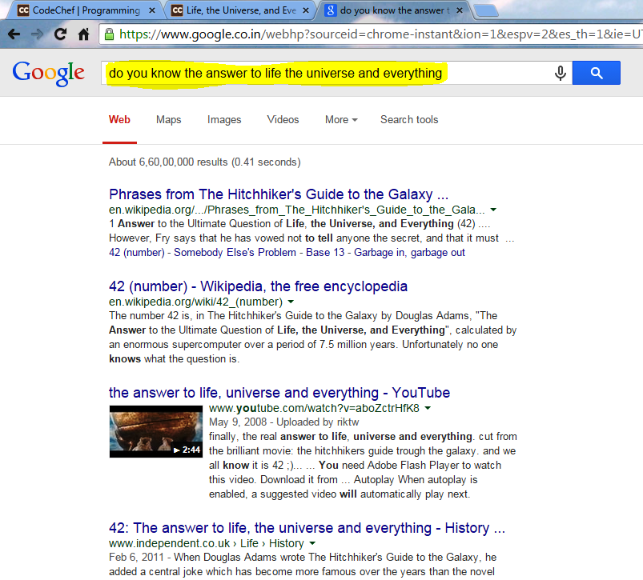

Slide 7

Algorithm
Continue to take input
Step 1:

Slide 8
Algorithm
Continue to take input(using scanf) inside a loop
Step 1:

Slide 9
Algorithm
Continue to take input(using scanf) inside a loop (here while loop)
while(condition) {
statement(s);
}
Step 1:
Syntax:

Slide 10
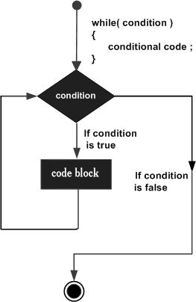
Algorithm
Continue to take input(using scanf) inside a loop
(here while loop)
while(condition) {
statement(s);
}
Step 1:
Syntax:

Slide 11
Algorithm
Determine the condition when the loop will terminate.
Step 2:

Slide 12
Algorithm
Determine the condition when the loop will terminate.
Syntax:
if(condition is satisfied)
Then stop processing input and break out of the loop.
else
Continue processing input.
Step 2:

Slide 13


Solution in C
#include<stdio.h>
void main(){
int num;
while( 1 ){ //condition which always accepts
scanf(“%d”,&num);
if(num == 42){
break;
}
printf(“%d\n”,num);
}
return;
}

Slide 14
Solution in C
#include<stdio.h>
void main(){
int num;
while( 1 ){ //condition which always accepts
scanf(“%d”,&num); //taking input as num
if(num == 42){
break;
}
printf(“%d\n”,num);
}
return;
}

Slide 15
Solution in C
#include<stdio.h>
void main(){
int num;
while( 1 ){ //condition which always accepts
scanf(“%d”,&num); //taking input as num
if(num == 42){ //checking for input = 42
break;
}
printf(“%d\n”,num);
}
return;
}

Slide 16
Solution in C
#include<stdio.h>
void main(){
int num;
while( 1 ){ //condition which always accepts
scanf(“%d”,&num); //taking input as num
if(num == 42){ //checking for input = 42
break; //stop processing the input
}
printf(“%d\n”,num);
}
return;
}

Slide 17
Solution in C
#include<stdio.h>
void main(){
int num;
while( 1 ){ //condition which always accepts
scanf(“%d”,&num); //taking input as num
if(num == 42){ //checking for input = 42
break; //stop processing the input
}
printf(“%d\n”,num); //printing the input
}
return;
}

Slide 18
Solution in C
#include<stdio.h>
void main(){
int num;
while( 1 ){ //condition which always accepts
scanf(“%d”,&num); //taking input as num
if(num == 42){ //checking for input = 42
break; //stop processing the input
}
printf(“%d\n”,num); //printing the input
}
return;
}
Identify error

Slide 19
Solution in C
#include<stdio.h>
void main(){
int num;
while( 1 ){ //condition which always accepts
scanf(“%d”,&num); //taking input as num
if(num == 42){ //checking for input = 42
break; //stop processing the input
}
printf(“%d\n”,num); //printing the input
}
return;
}
Identify error
If any!!!

Slide 20
What is it?
#include<stdio.h>
void main(){
int num;
while( 1 ){ //condition which always accepts
scanf(“%d”,&num); //taking input as num
if(num == 42){ //checking for input = 42
break; //stop processing the input
}
printf(“%d\n”,num); //printing the input
}
return;
}
Nzec error

Slide 21

NZEC(Non Zero Exit Code)
#include<stdio.h>
void main(){ //void should be changed to int
int num;
while( 1 ){
scanf(“%d”,&num);
if(num == 42){
break;
}
printf(“%d\n”,num);
}
return;
}

Slide 22


NZEC(Non Zero Exit Code)
#include<stdio.h>
int main(){
int num;
while( 1 ){
scanf(“%d”,&num);
if(num == 42){
break;
}
printf(“%d\n”,num);
}
return; //Should be return 0
}

Slide 23

Final solution in C
#include<stdio.h>
int main(){
int num;
while( 1 ){
scanf(“%d”,&num);
if(num == 42){
break;
}
printf(“%d\n”,num);
}
return 0;
}

Slide 24
Final solution in C
#include<stdio.h>
int main(){
int num;
while( 1 ){
scanf(“%d”,&num);
if(num == 42){
break;
}
printf(“%d\n”,num);
}
return 0;
}
ACCEPTED

Slide 25

Second Problem:
Name: Second Max of Three Numbers
Code : START05
Time Limit : 1 second
Source Limit: 50,000 bytes

Slide 26
Second Max of Three Numbers
Write a program that keeps accepting three numbers, and prints the second maximum number among the three.
Problem Statement:

Slide 27
Second Max of Three Numbers
Write a program that keeps accepting three numbers, and prints the second-maximum number among the three.
Input: Output:
1 2 3 2
10 15 5 10
100 999 500 500
Problem Statement:

